Slide 1
Functional Plant Bioinformatics
Using PLAZA to get more out of your plant omics data
21-22 October, 2019
Klaas Vandepoele
Michiel Van Bel

Slide 2
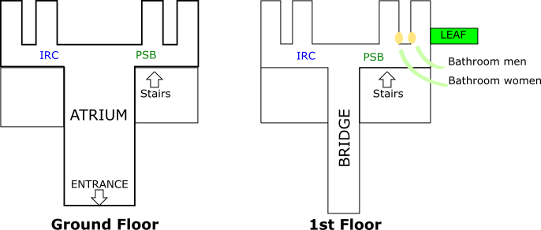
Workshop General Information
Location workshop: Meeting room “Leaf” (E124)
Location lunch/breaks: Atrium

Slide 3
Workshop Schedule
Day | Timeframe | Time (minutes) | Session Content | Teacher/Moderator
Monday 21 Oct | 09:30-09:45 | 15 | Welcome: general info meeting room, lunch, breaks, dinner | Michiel
 | 09:45-10:00 | 15 | Short introduction participants (species/biological process of interest) | Michiel
 | 10:00-10:30 | 30 | PLAZA Introduction | Klaas
 | 10:30-11:00 | 30 | Coffee break
 | 11:00-11:30 | 30 | Theory I: genes, gene families, and genome organization | Klaas
 | 11:30-12:30 | 60 | Excercises I: genes, gene families, and genome organization | Michiel
 | 12:30-13:30 | 60 | Lunch
 | 13:30-14:15 | 45 | Theory II: Orthologs, paralogs, and phylogenetic trees | Klaas
 | 14:15-15:15 | 60 | Excercises II: Orthologs, paralogs, and phylogenetic trees | Michiel
 | 15:15-15:45 | 30 | Coffee break
 | 15:45-16:15 | 30 | Theory III: Functional annotation & functional enrichments | Michiel
 | 16:15-17:00 | 45 | Excercises III: Functional annotation | Michiel
 | 17:00-19:00 | 120 | Allow participants to reach Café des Arts (and drop off their luggage)
 | 19:00 |  | Diner Café des Arts
Tuesday 22 Oct | 09:30-10:15 | 45 | Theory IV: PLAZA Workbench | Michiel
 | 10:15-10:45 | 30 | Excercises IVa: PLAZA Workbench registration + upload gene set(s) | Michiel
 | 10:45-11:15 | 30 | Coffee break
 | 11:15-12:00 | 45 | Excercises IVb: PLAZA Workbench functional data analysis | Michiel
 | 12:00-13:00 | 60 | Lunch
 | 13:00-13:45 | 45 | Theory V: Advanced orthology, synteny, and expression analysis in cereals | Klaas
 | 13:45-14:45 | 60 | Excercises Va: Advanced orthology, synteny, and expression analysis in cereals | Klaas
 | 14:45-15:15 | 30 | Coffee break
 | 15:15-16:00 | 45 | Excercises Vb: Advanced orthology/synteny using PLAZA workbench | Klaas
 | 16:00-16:30 | 30 | Feedback + closing workshop

Slide 4
Diner @ City Center
When?
Monday 21/10/2019, 19h00
Where?
Café Des Arts
Schouwburgstraat 12, 9000 Ghent

