Slide 1
Functional Plant Bioinformatics
Genes, gene families, and phylogenetics
May 12th, 2026
Klaas Vandepoele
Michiel Van Bel
Sander Thierens

Slide 2

Search function & gene identifiers
Different search functions available
  Keyword (gene description, gene symbol)
    Try to filter based on (model) species of interest
    BUT caveats due to missing gene descriptions
    Use “View associated gene families” to summarize results
  Gene Ontology or InterPro
  Accession number or gene identifier
    Both original as PLAZA gene identifier are supported
Notes:
Could be removed I think

Slide 3
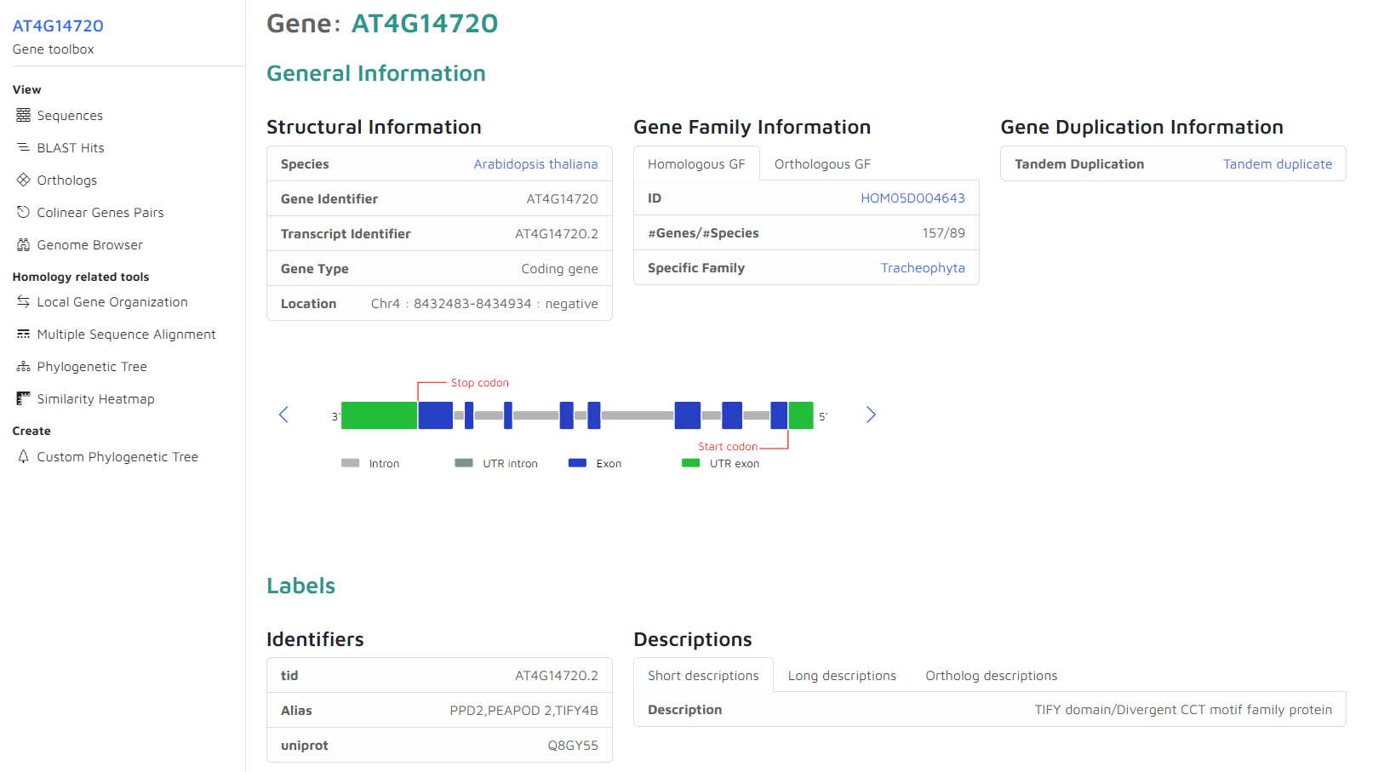
Gene Page (A) : Structural Information

Slide 4
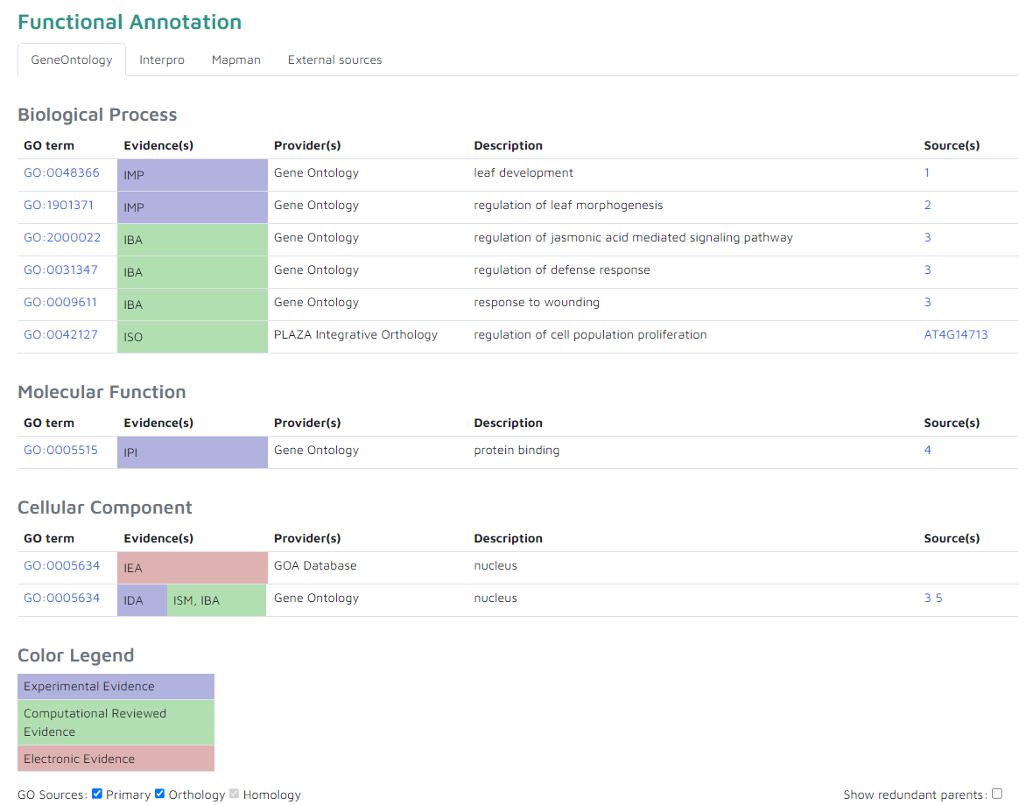
Gene Page (B) : Functional Annotations

Slide 5
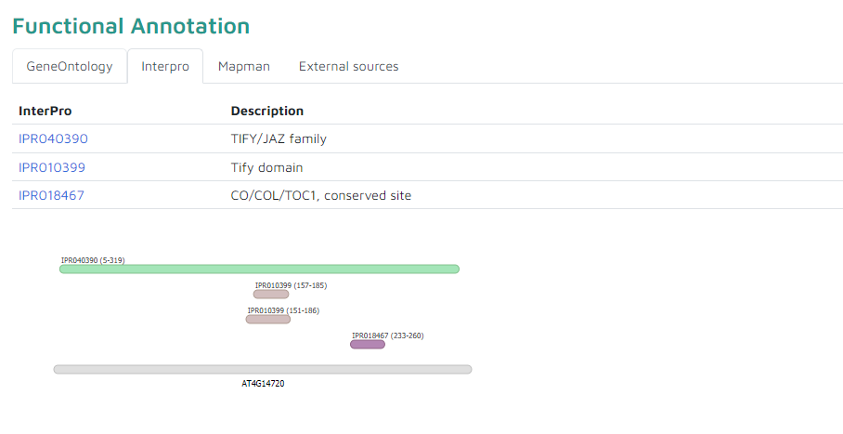
Gene Page (B) : Functional Annotations

Slide 6
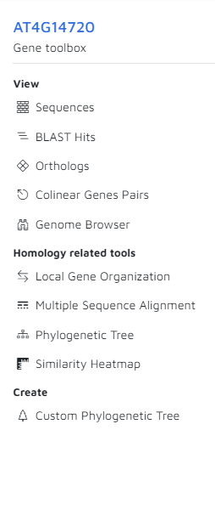
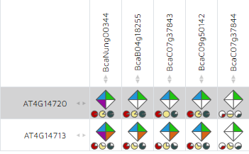
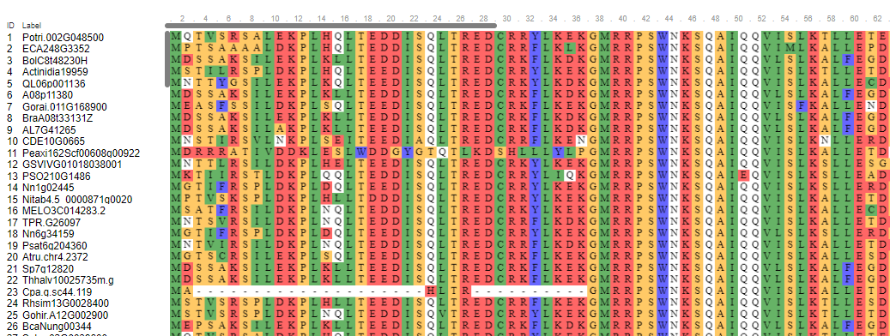
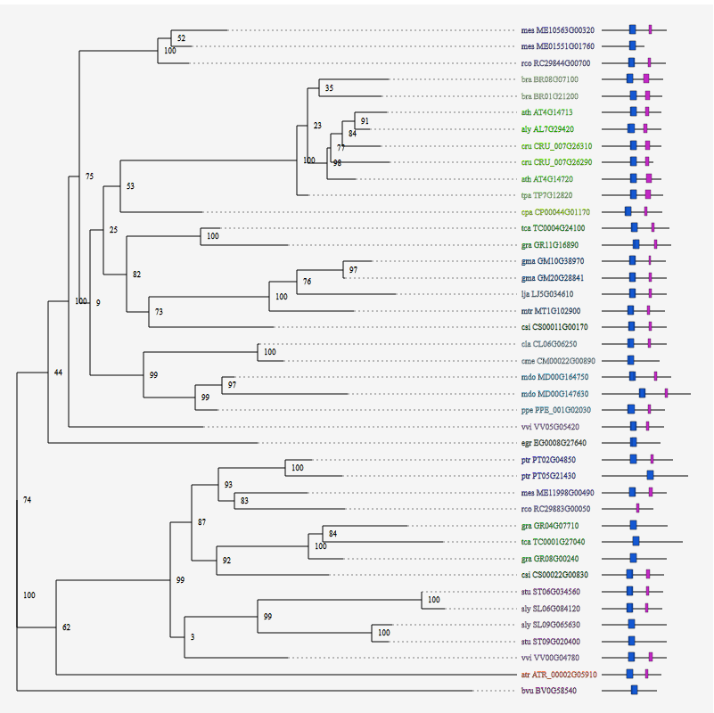
Gene Page (C) : Toolbar

Slide 7
Homology & gene families
Homology = shared ancestral common origin
Inferred based on:
  Sequence similarity
  Similar (multi-) protein domain composition and organization
So sequence similarity means homology?
  No! It depends!
PLAZA
➔ Automatically cluster homologous genes into gene families

Slide 8
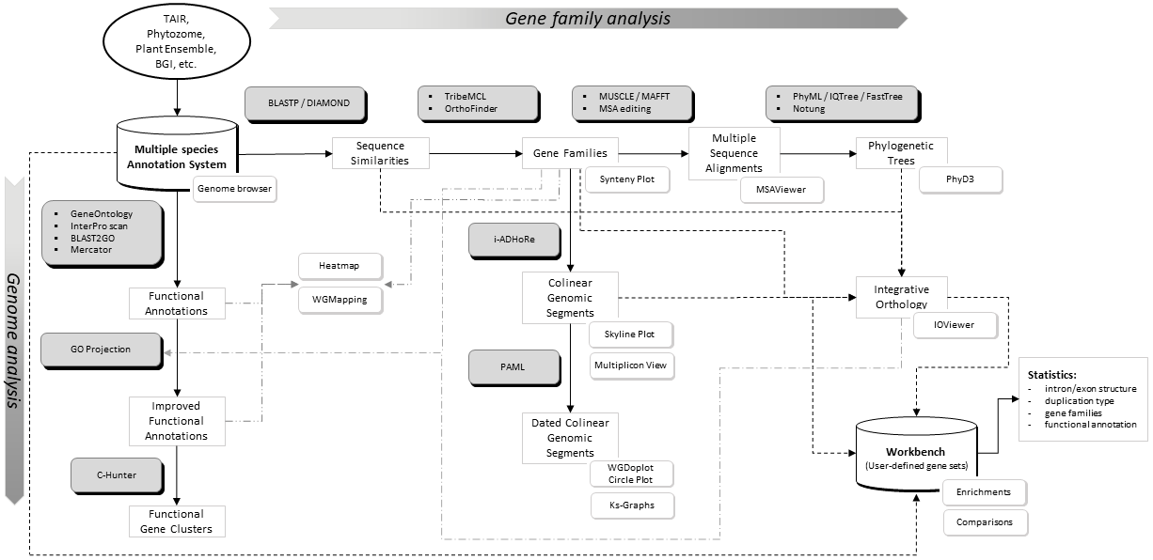
Different data axis in PLAZA: Gene Families
Sequences (~taxa)

Slide 9
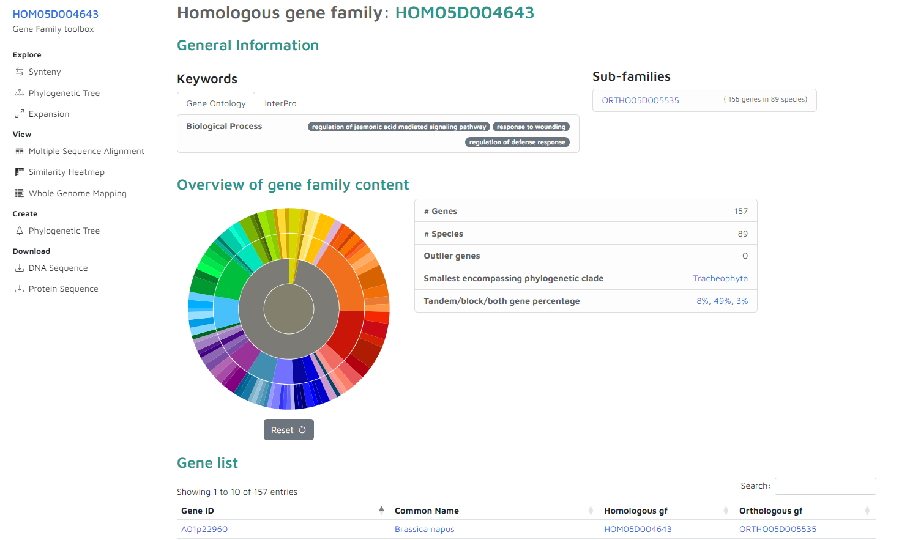
Gene Family Page

Slide 10
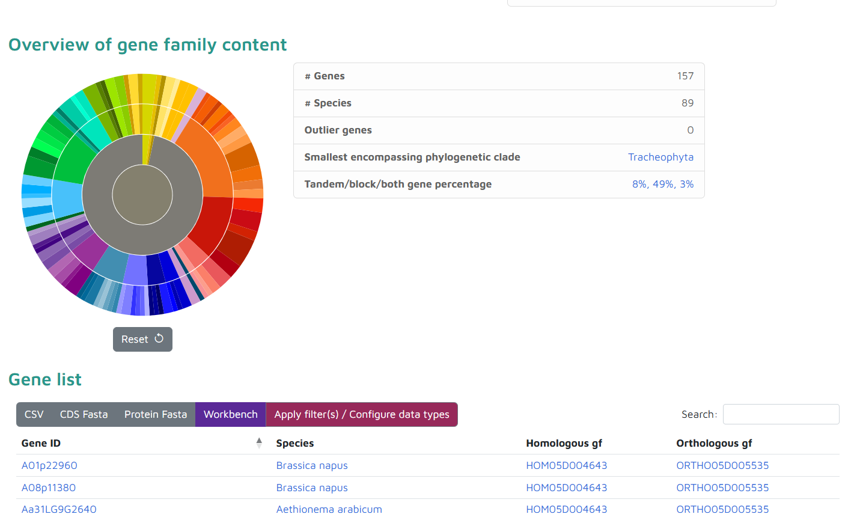
Gene Family Page : Gene List
Gene list per species
Use pie-chart
Filter using search

Slide 11
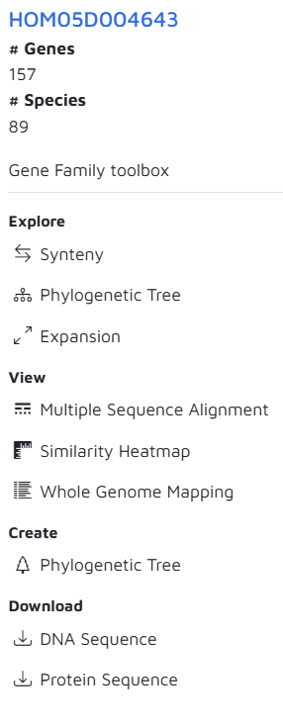
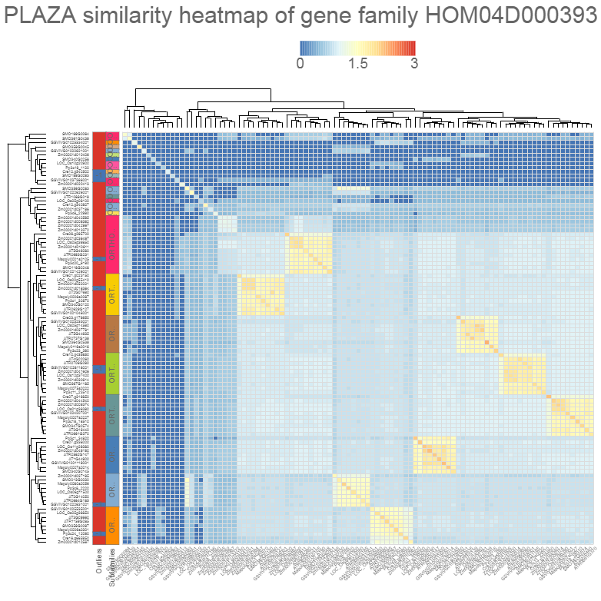
Gene family similarity heatmap
Mini-chromosome maintenance (MCM) protein

Slide 12
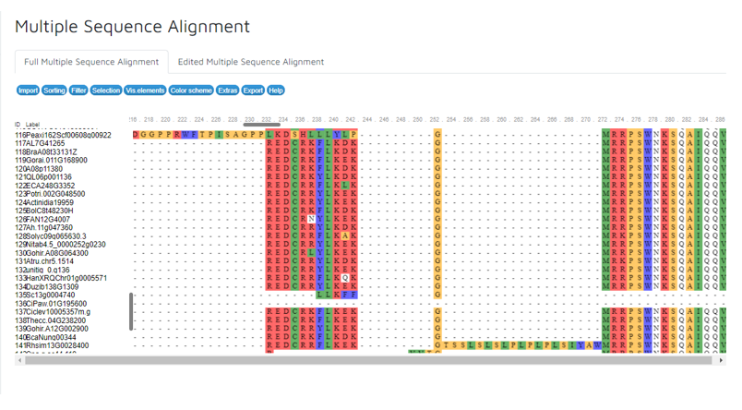
Multiple sequence alignment

Slide 13
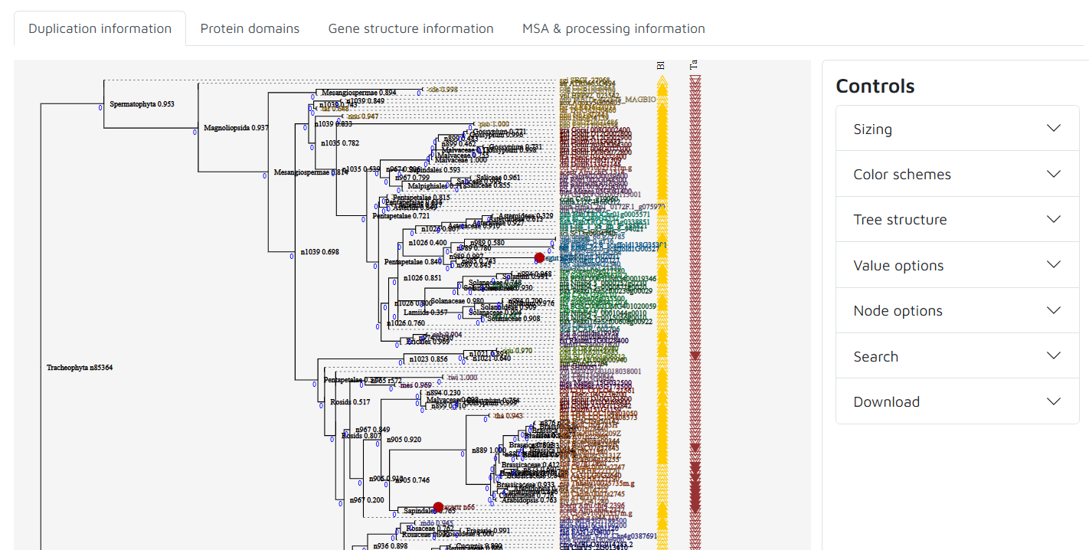
Phylogenetic trees
The same tree with different additional information

Slide 14
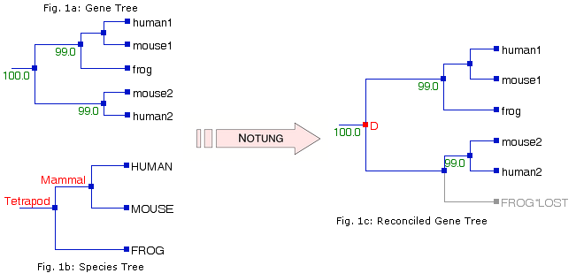
Tree reconciliation
The automatic detection of speciation and duplication events using a species tree and gene family tree

Slide 15
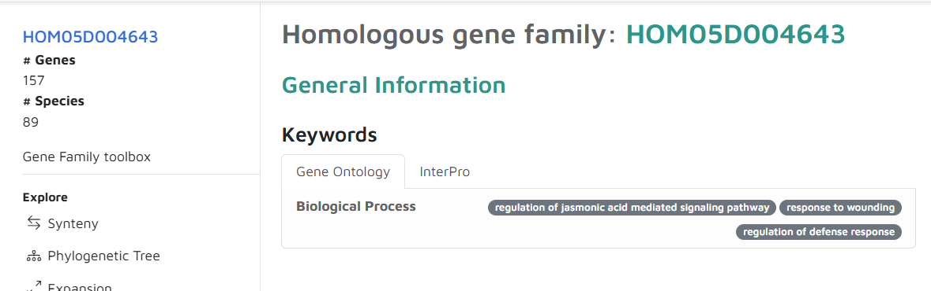
Gene Family Page : Functional Annotation
GO-terms are automatically assigned to gene families based on
  Enrichment statistics
  Fraction of genes in the family with the GO term
Does not mean that ALL genes of the family have that GO term
Multiple families can be annotated with the same GO term

Slide 16
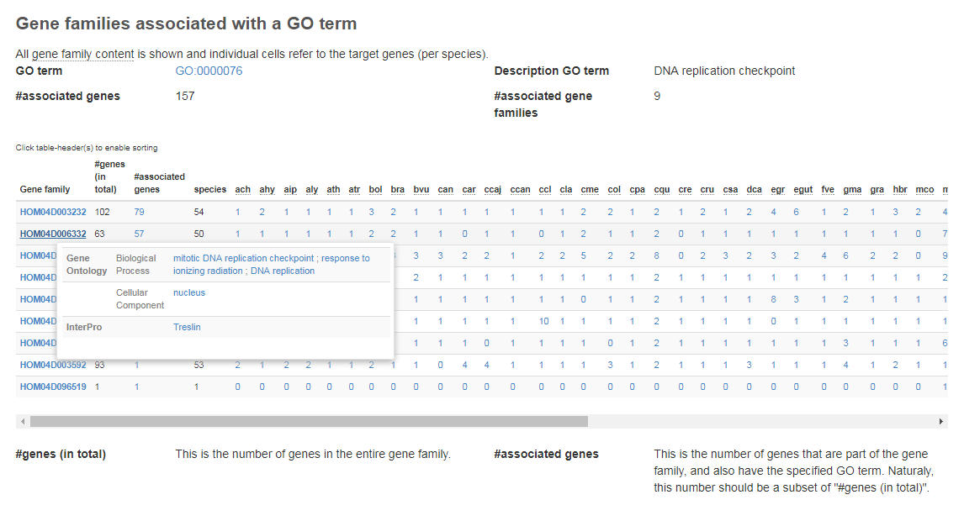
Associated gene families & phylogenetic profiles

