Slide 1
Functional Plant Bioinformatics
Using PLAZA to get more out of your plant omics data
May 12th, 2026
Klaas Vandepoele
Michiel Van Bel
Sander Thierens

Slide 2
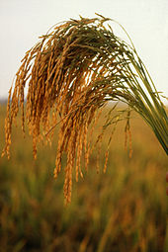
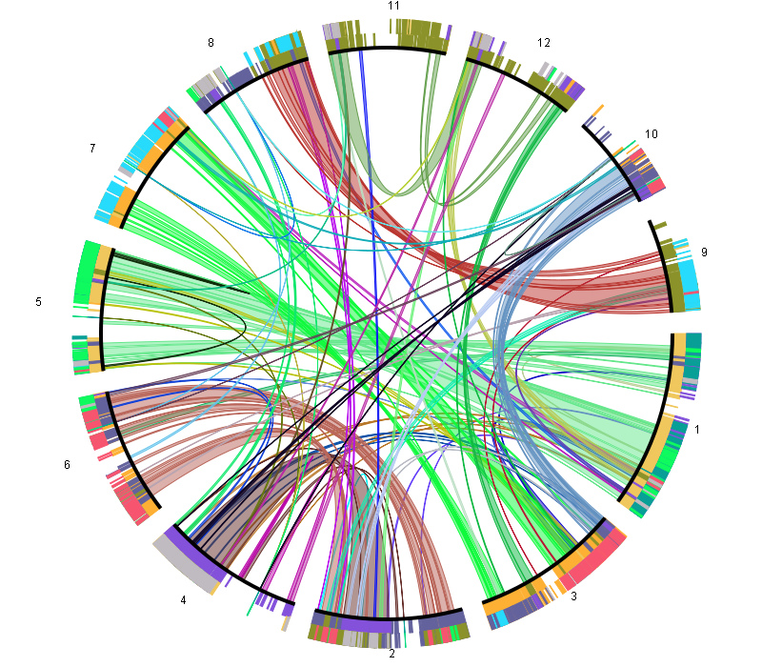
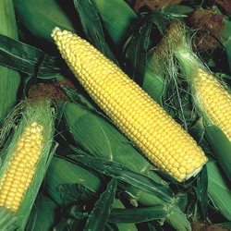
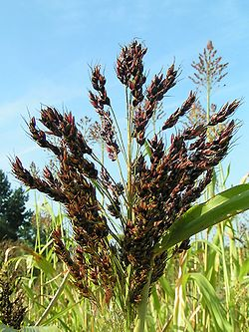
Cross-species genome analysis
Comparative genomics is a powerful tool
  to transfer knowledge from model species to crops
  to link genomic changes to environmental adaptation
  to trace structural changes within a genome or population
Notes:
Comparative genomics can be performed at different levels: genome level to study chromosome biology, at the gene level to study pathways or GFs, but also at the DNA level to for example identify CVs, SNPS. In all these cases, setting up CG workflows is not easy, as you need to handle a lot of data, combine several tools and also make sure the performance of your methods scales well with for example extra genomes.

Slide 3
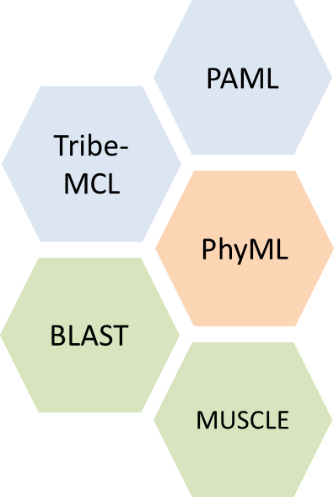
Cross-species genome analysis
Comparative genomics has a steep learning curve
  Gathering data in the same state incl. proper QC, ready for processing, is not effortlessly
  Knowledge of data processing tools is required
  Computer clusters and high memory machines are required
  User friendly visualizations are necessary to explore genomic features across multiple species
  Limited access to high quality comparative genomics information
Notes:
Comparative genomics can be performed at different levels: genome level to study chromosome biology, at the gene level to study pathways or GFs, but also at the DNA level to for example identify CVs, SNPS. In all these cases, setting up CG workflows is not easy, as you need to handle a lot of data, combine several tools and also make sure the performance of your methods scales well with for example extra genomes.

Slide 4
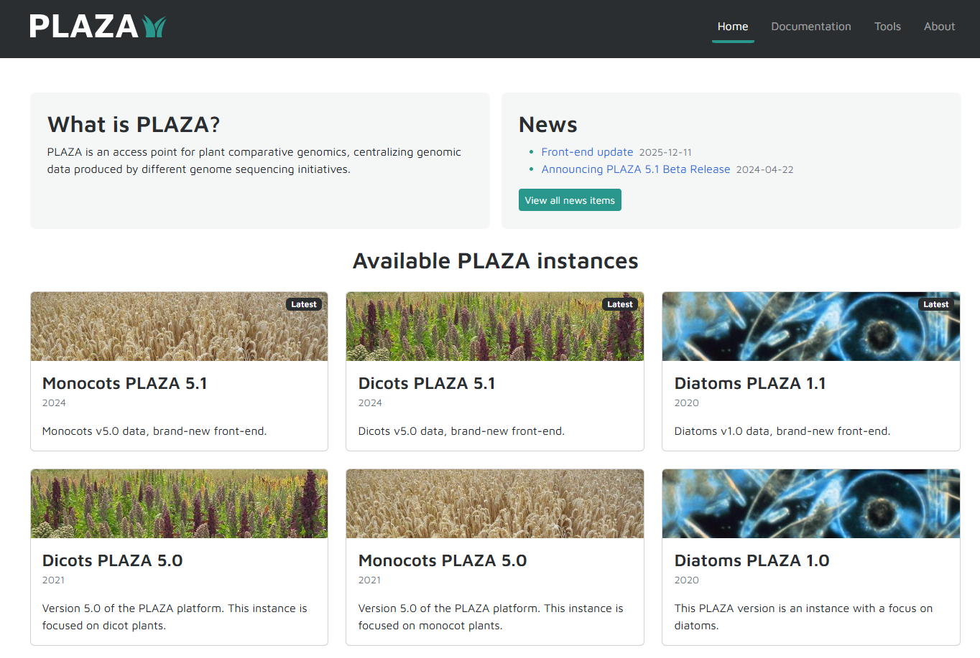
https://www.vandepoelelab.be/plaza/
Notes:
10 years ago, we started developing PLAZA. Integrative resource for plant genomics, with a focus on comp. genomics. Different PLAZA dbs have been developed, depending on which species with the green plant lineage you like best.

Slide 5
Version we will use in this workshop
https://www.vandepoelelab.be/plaza/
Notes:
10 years ago, we started developing PLAZA. Integrative resource for plant genomics, with a focus on comp. genomics. Different PLAZA dbs have been developed, depending on which species with the green plant lineage you like best.

Slide 6
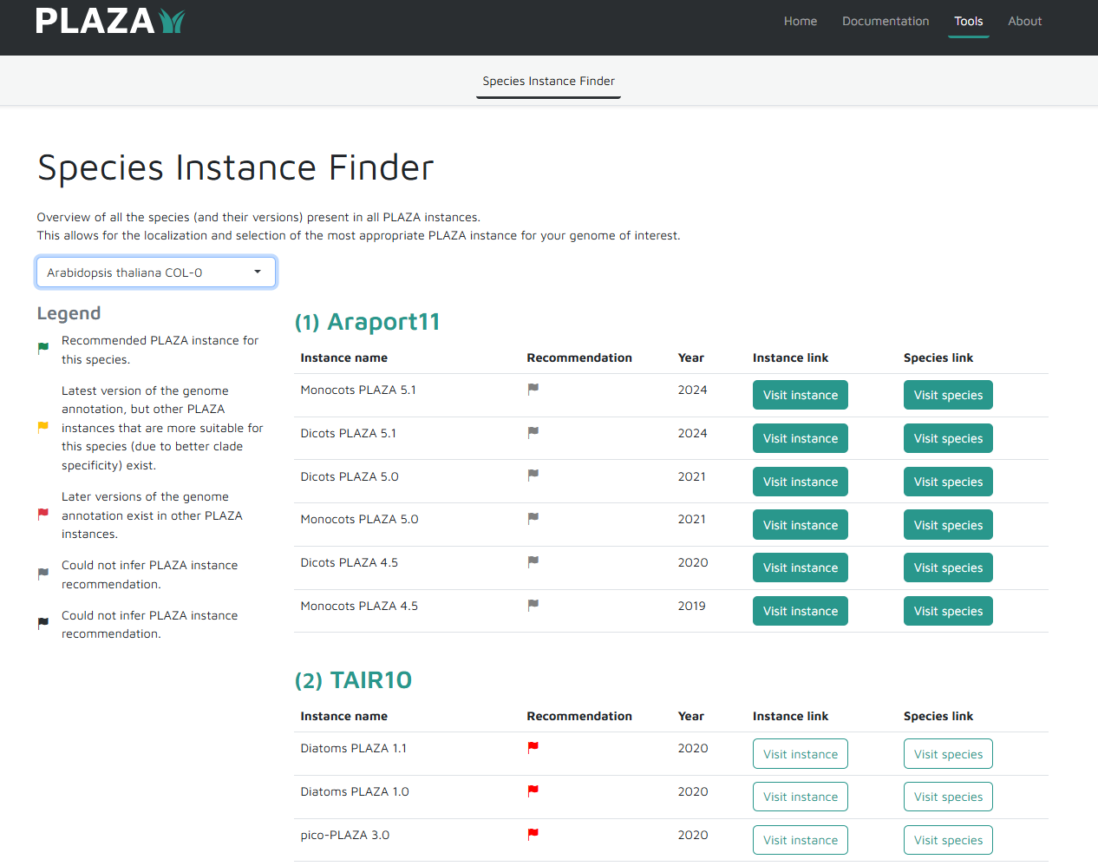
PLAZA instance finder
Problem
Multiple genome versions of the same species are available (assembly/annotation)
Multiple PLAZA instances are available
➔ In which PLAZA instance is my species of interest present?
➔ Use the Species Instance Finder

Slide 7
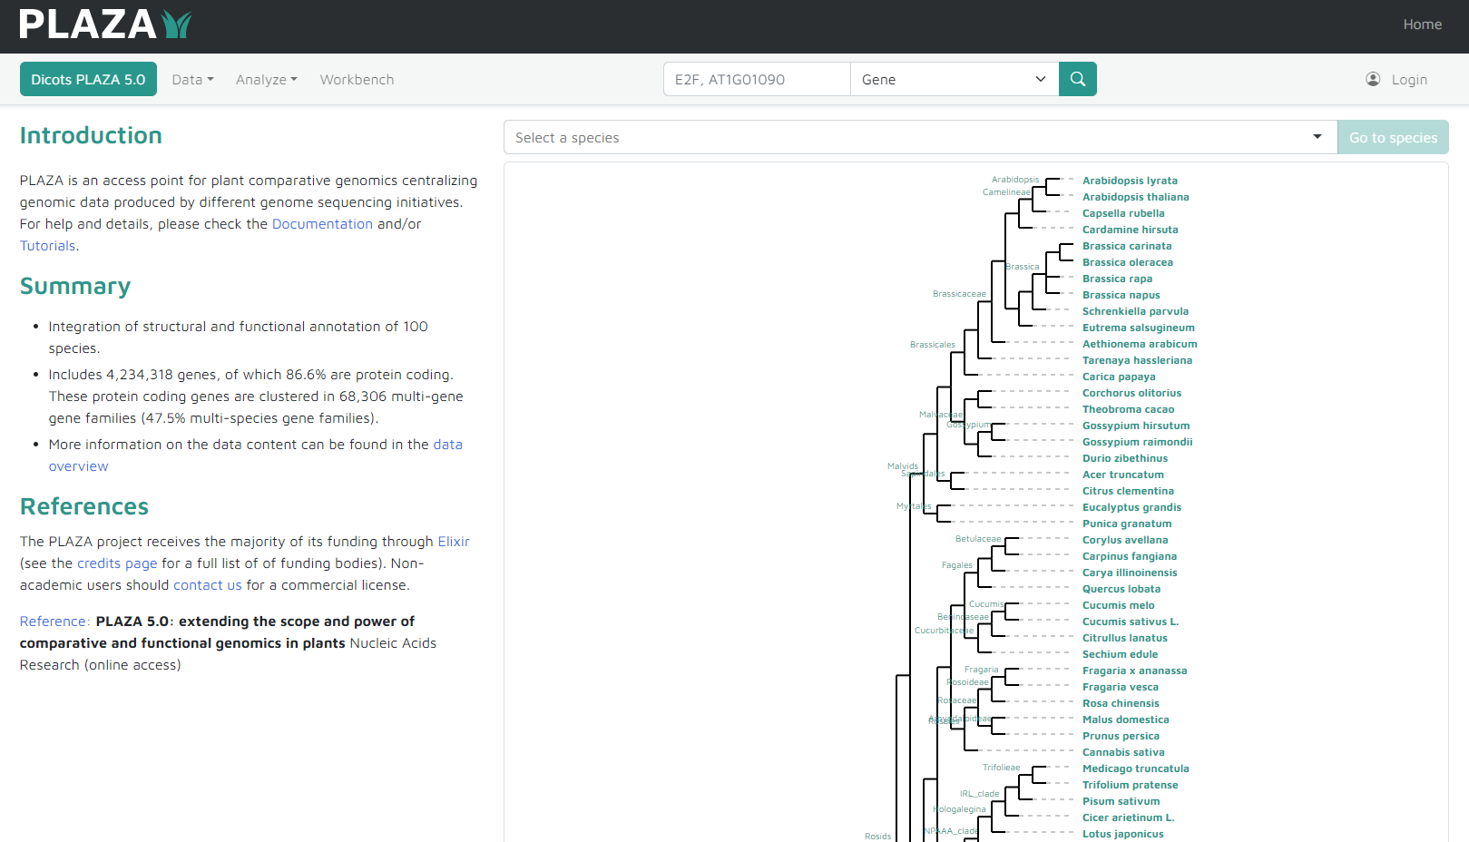
PLAZA Instance Main Page
Search bar
Data overview and downloads
Authentication for workbench
Available Species
Tools and Visualizations

Slide 8
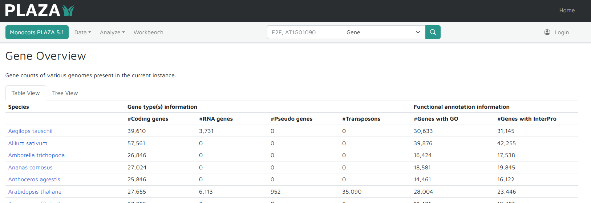
Data Overview

Slide 9
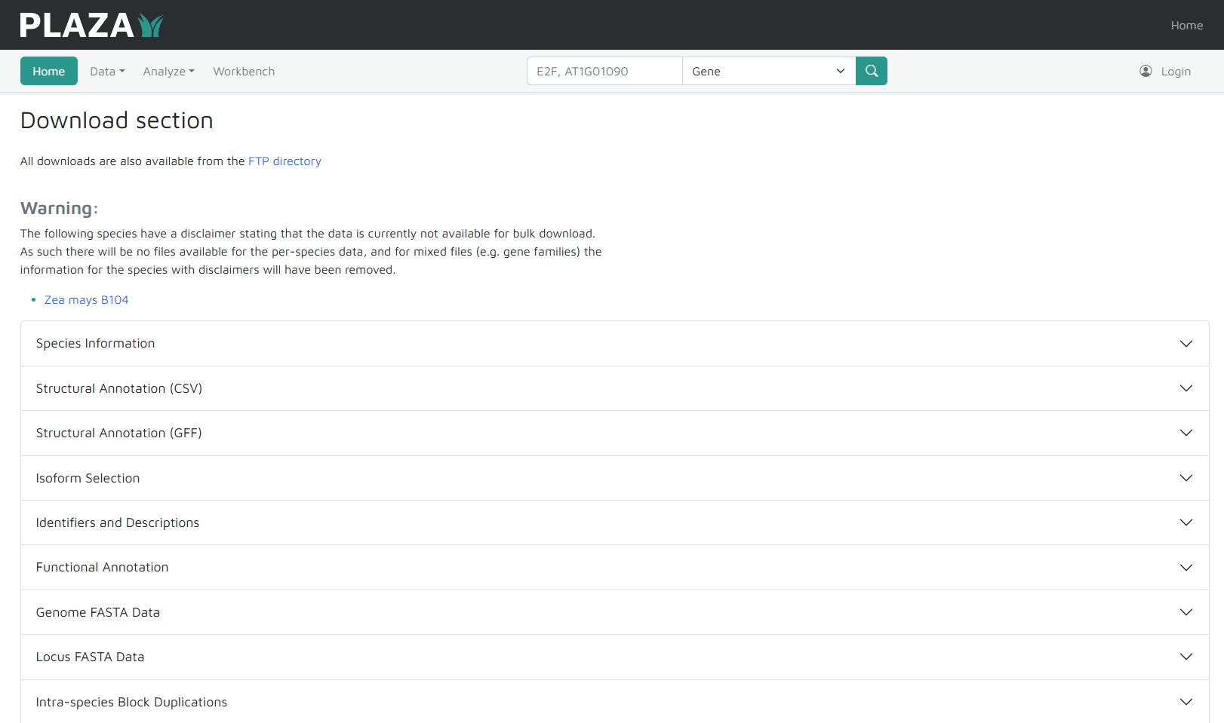
Data Downloads
Content organized per:
  Data type
  Species
  Isoform-selection

Slide 10
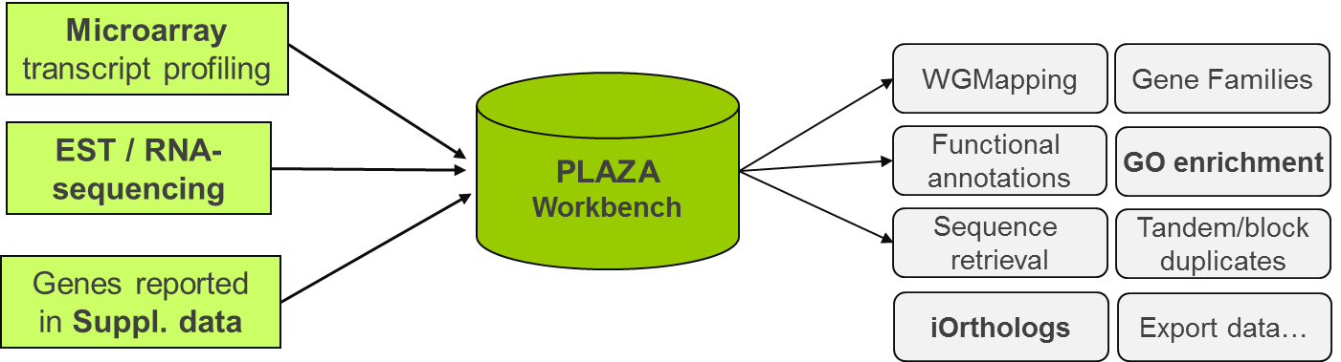
PLAZA Workbench
Create a custom gene set (~experiment) using gene identifiers or BLAST
  External/internal gene IDs (e.g. AN3, AT5G28640, GRMZM2G180246_T01)
  BLAST interface can be used to map sequence data from a non-model species to a reference species present in PLAZA
A toolbox is available to analyze user-defined gene sets (~experiment)
INPUT
OUTPUT: PLAZA Data analysis

Slide 11
How to find what you are looking for?
http://www.vandepoelelab.be/plaza/documentation
Glossary
Documentation
  Data content
  Construction
  Tools
Tutorials & FAQ
Publications

Slide 12
Further reading
Core Publications
  Van Bel, M., Silvestri, F., Weitz, E., Kreft, L., Botzki, A., Coppens, F., Vandepoele, K. (2022) PLAZA 5.0: Extending the scope and power of comparative and functional genomics Nucleic Acids Res. 50 (Database issue): D1468-1474
  Van Bel, M., Diels, T., Vancaester, E., Kreft, L., Botzki, A., Van de Peer, Y., Coppens, F., Vandepoele, K. (2017) PLAZA 4.0: an integrative resource for functional, evolutionary, and comparative plant genomics Nucleic Acids Res. 46 (Database issue): D1190-1196
  * Proost, S., * Van Bel, M., Vaneechoutte, D., Van de Peer, Y., Inzé, D., Mueller-Roeber, B., Vandepoele, K. (2014) PLAZA 3.0: an access point for plant comparative genomics. Nucleic Acids Res. 43(Database issue):D974-81
  * Van Bel, M., * Proost, S., Wischnitzki, E., Movahedi, S., Scheerlinck, C., Van de Peer, Y., Vandepoele, K. (2012) Dissecting plant genomes with the PLAZA comparative genomics platform. Plant Physiol. 158(2):590-600
  * Proost, S., * Van Bel, M., Sterk, L., Billiau, K., Van Parys, T., Van de Peer, Y., Vandepoele, K. (2009) PLAZA: a comparative genomics resource to study gene and genome evolution in plants. Plant Cell. 21(12):3718-31

Slide 13
Conclusions
PLAZA provides a versatile toolbox for plant genomics
Integration of complementary data sources describing gene functions
Improved algorithms to transfer functional annotation from well-characterized plant genomes to other species
Technical improvements
  database design
  comparative genomics toolbox
  speed
  interactive visualizations

