Slide 1
Functional Plant Bioinformatics
Using PLAZA to get more out of your plant omics data
May 12th, 2026
Klaas Vandepoele
Michiel Van Bel
Sander Thierens

Slide 2
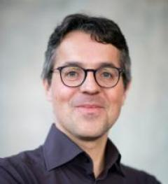
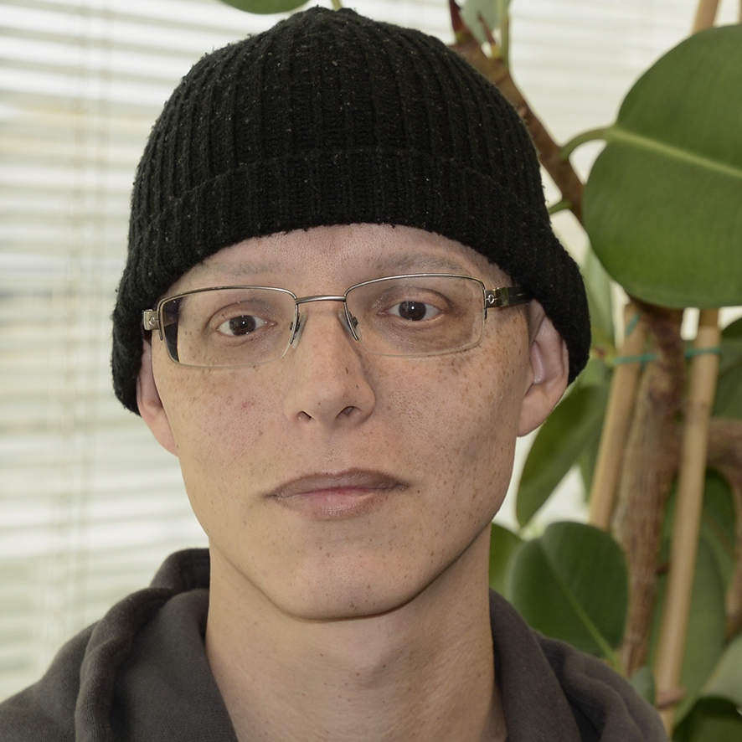
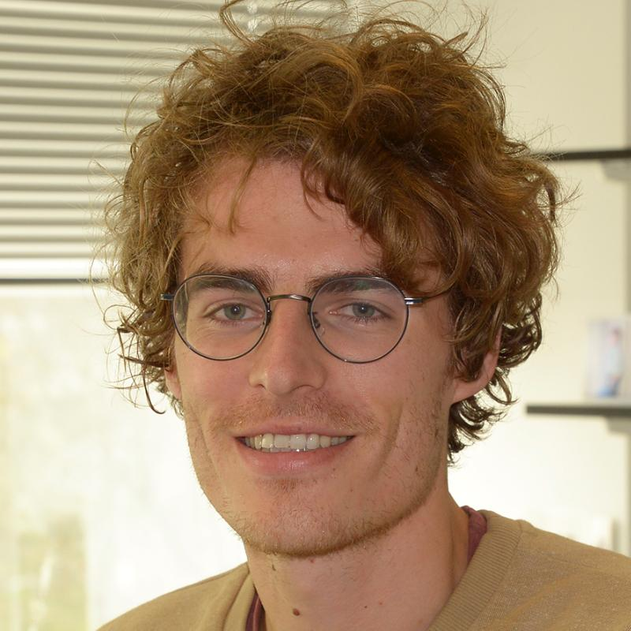
People
Trainers
Prof. Dr. Klaas Vandepoele
Dr. Michiel Van Bel
Sander Thierens

Slide 3
People
Trainers
Prof. Dr. Klaas Vandepoele
Dr. Michiel Van Bel

Slide 4
Workshop Schedule
Monday May 12th | Time | Duration
 | 09:00-09:30 | 30 | Welcome + Introduction PLAZA platform + first exploration (instances, data overview, species page)
 | 09:30-10:15 | 45 | Genes, gene families, and phylogenetics
 | 10:15-10:45 | 30 | Break
 | 10:45-11:15 | 30 | Colinearity, Synteny, and Polyploidy
 | 11:15-12:00 | 45 | Orthologs, paralogs, and integrative orthology viewer
 | 12:00-13:00 | 60 | Lunch
 | 13:00-14:00 | 60 | Gene functional annotations (GO, InterPro, MapMan)
 | 14:00-14:30 | 30 | Introduction Workbench
 | 14:30-15:00 | 30 | Break
 | 15:00-16:00 | 60 | Workbench (RNA-seq DEG scRNA-seq Zma [1] )
 | 16:00-16:45 | 45 | Workbench (Cross-species analysis root marker genes [2] )
 | 16:45-17:00 | 15 | Concluding remarks

