Slide 1
Functional Plant Bioinformatics
The PLAZA workbench
September 15th 2026
Klaas Vandepoele
Michiel Van Bel

Slide 2
Small-scale operations on large-scale data
Default PLAZA usage:
  Search for a gene or functional term
  Explore associated web pages
  Write down results
  Repeat …
  Imagine doing this for a 1000 differentially regulated genes from an RNA-seq experiment…

Slide 3
Large scale solution for large scale data :
The PLAZA workbench
Work with sets of genes compared to single genes
Compare, merge, differentiate between gene sets
Apply set-specific tools
  functional enrichments
  Locational biases
  Etc…

Slide 4
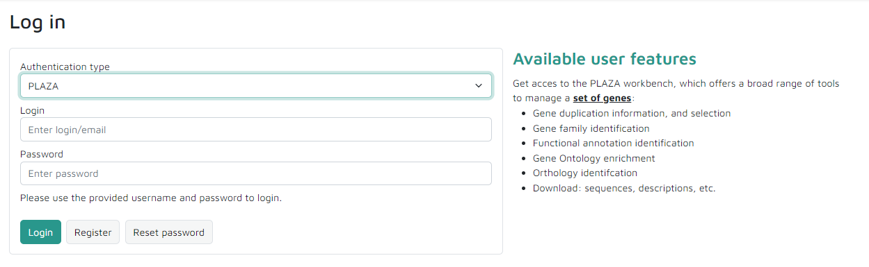
The PLAZA workbench: A quick how-to
1. Register for a free workbench account
  Security: Analyzes are not public
  History: Keep track of analyzes

Slide 5
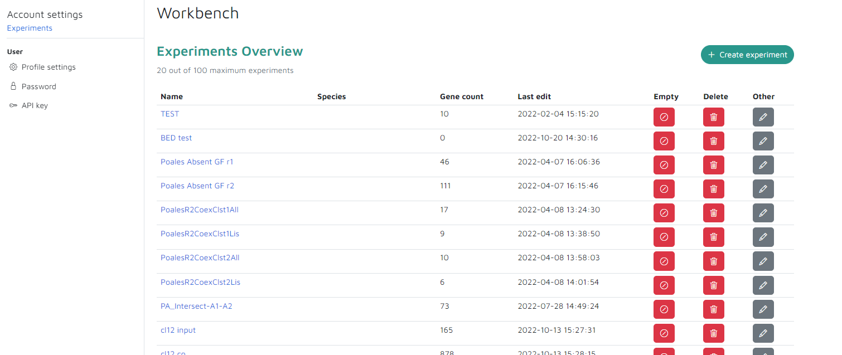
The PLAZA workbench: A quick how-to
2. Create experiment

Slide 6
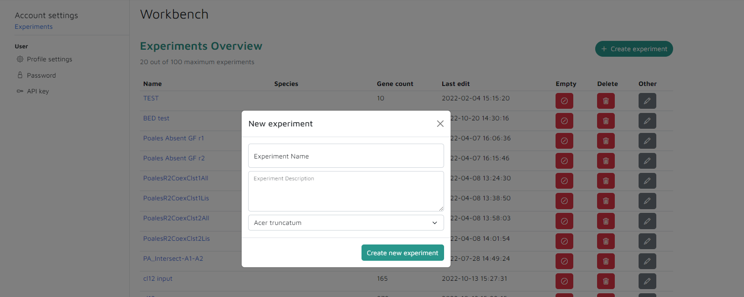
The PLAZA workbench: A quick how-to
2. Create experiment

Slide 7
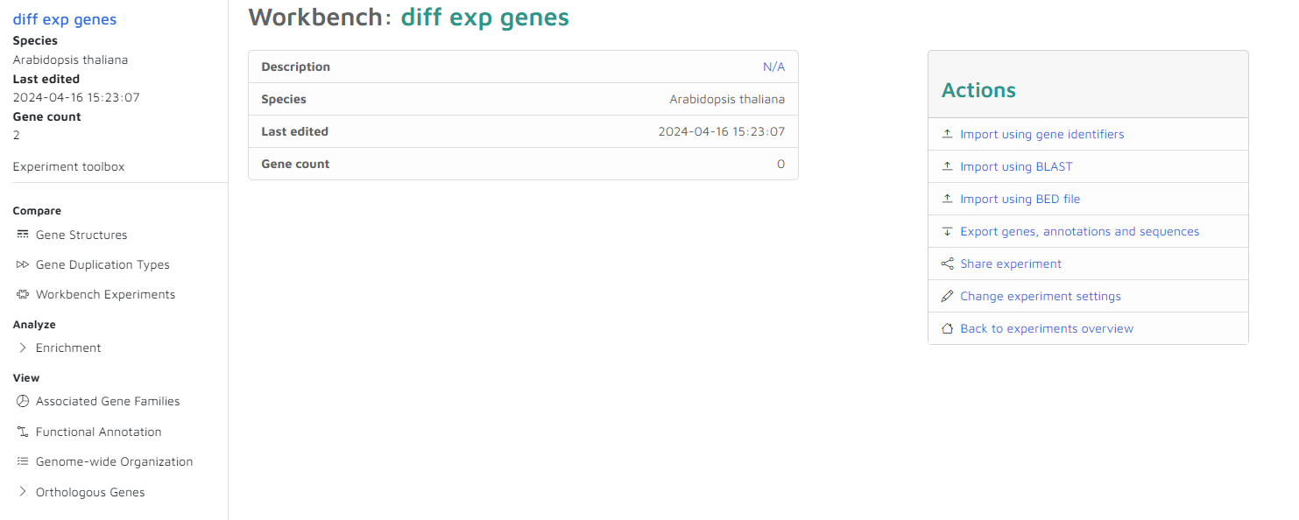
The PLAZA workbench: A quick how-to
3. Upload genes into the gene set

Slide 8
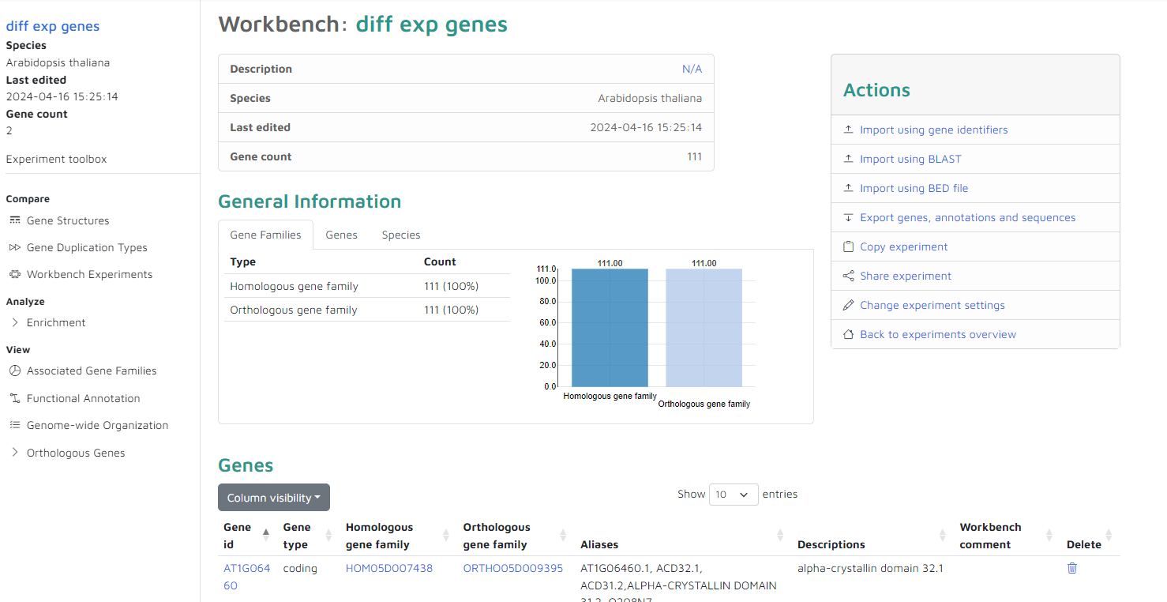
PLAZA workbench analyzes

Slide 9
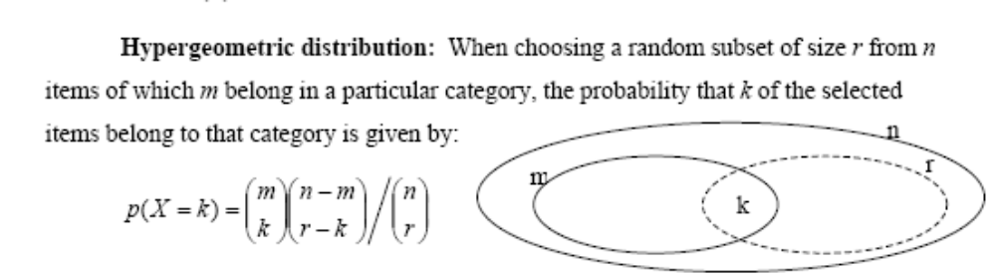
Functional Enrichment analysis
Determines the over/under-representation of a certain GO term in a gene set compared to the genome-wide background frequency
The significance is determined using the hypergeometric distribution (incl. multiple testing correction)
freq(gene set)
Enrichment fold =
freq(background)

Slide 10
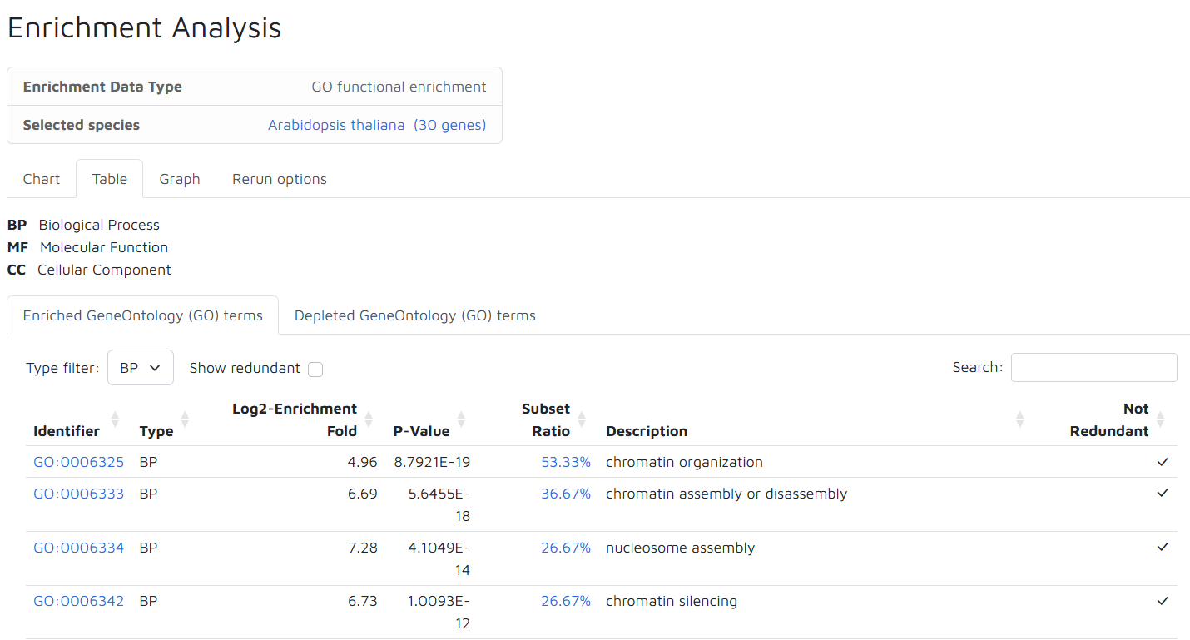
Interpretation enrichment results

Slide 11
PLAZA workbench : demo

