Slide 1
Functional Plant Bioinformatics
Gene functional annotations
GO, InterPro, and MapMan
September 15th, 2026
Klaas Vandepoele
Michiel Van Bel

Slide 2
Overview
Basic information about the Functional Ontologies used in the PLAZA platform for annotating genes
Functional Enrichment of sets of genes
Mapping of GO annotations between genes
Annotating gene families in the PLAZA platform

Slide 3
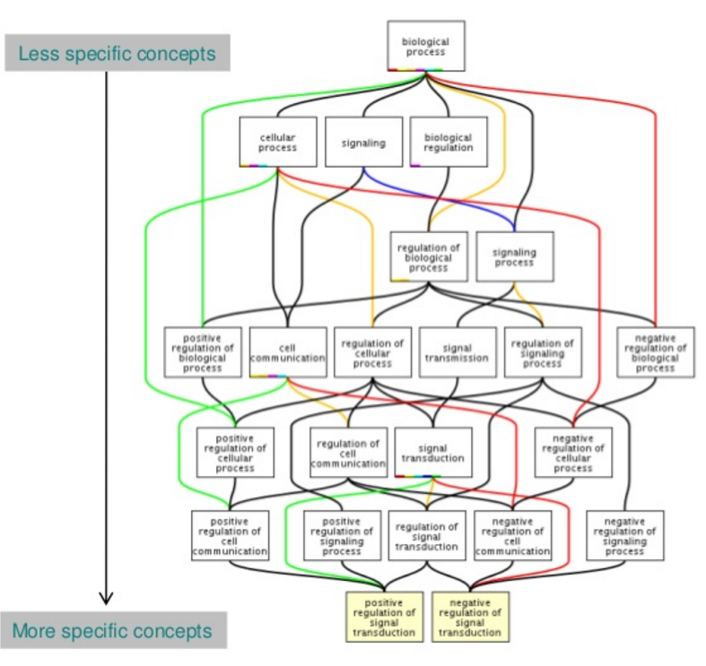
Sample GO term
id: GO:0016049
name: cell growth
namespace: biological_process
def: "The process in which a cell irreversibly increases in size over time by accretion and biosynthetic production of matter similar to that already present." [GOC:ai]
subset: goslim_generic
subset: goslim_plant
subset: gosubset_prok
synonym: "cell expansion" RELATED []
synonym: "cellular growth" EXACT []
synonym: "growth of cell" EXACT []
is_a: GO:0009987 ! cellular process
is_a: GO:0040007 ! growth
relationship: part_of GO:0008361 ! regulation of cell size
GO annotation is the process of assigning GO terms to gene products.
Notes:
+ A collaborative effort to address the need for consistent descriptions of gene products across databases
+ The GO project has developed three structured ontologies that describe gene products in a species-independent manner
+ An ontology is a formal representation of a body of knowledge, within a given domain. Ontologies usually consist of a set of classes or terms with relations that operate between them.

Slide 4
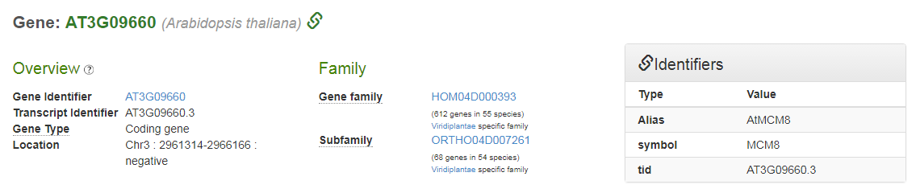
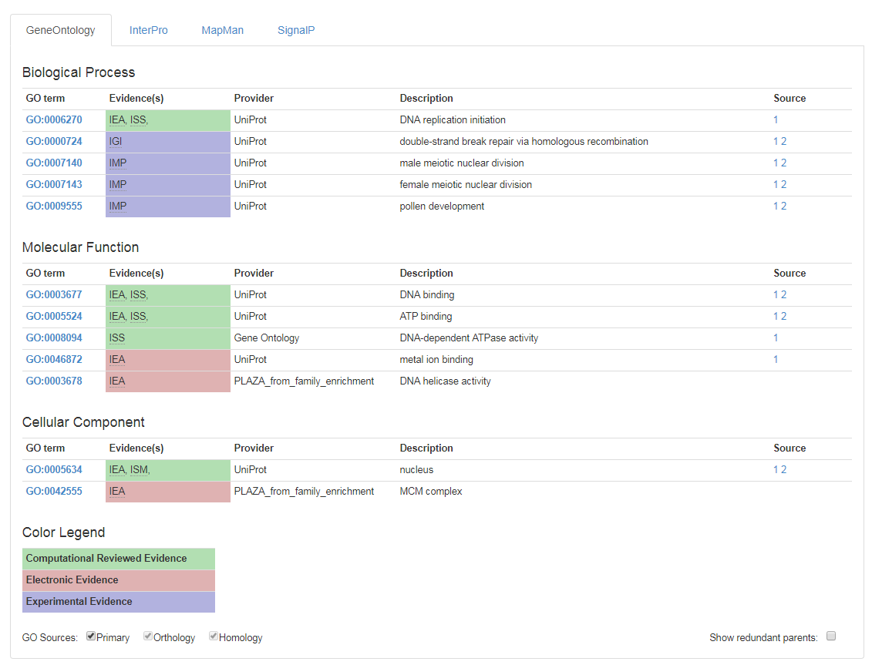
Gene Page: functional GO information

Slide 5
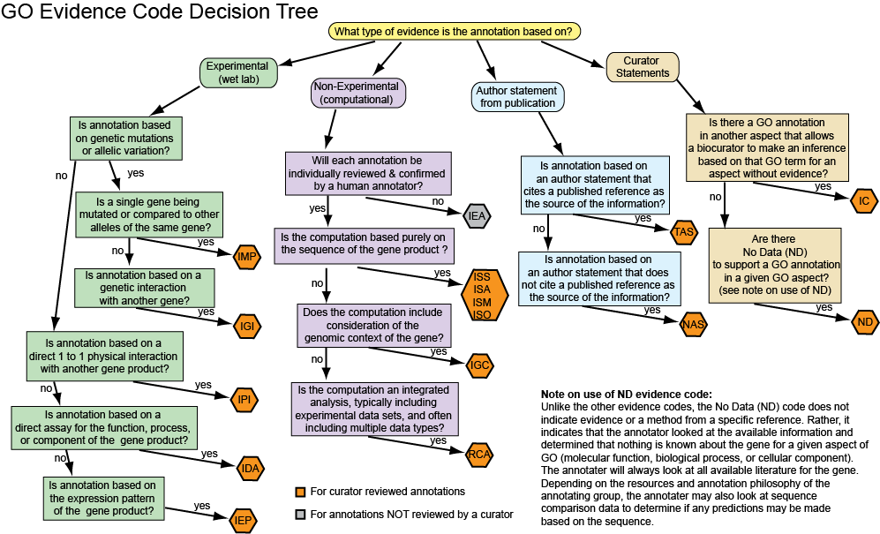
GO evidence codes

Slide 6
Common usage of the GO hierarchy
Return all the genes that are annotated with GO-term A
  Include also all the genes that have been annotated with the children of GO-term A
  For example:
    Return all the genes annotated with ‘Response to stress’ (GO:0006950)
    Include genes that are annotated with the children (‘Response to biotic stress’, ‘Response to abiotic stress’) but not with ‘Response to stress’ directly.
Return all the GO terms that have been annotated with gene B
  Include also all the GO terms that are the parents of the explicitly annotated GO terms.
  For example:
    Return all the GO terms that are associated with AT1G21850
    Standard answer (within Molecular Function) is ‘copper ion binding’ (GO:0005507)
    This implies that the gene is also annotated with the parental terms ‘transition metal ion binding’, ‘metal ion binding’, ‘cation binding’, ‘ion binding’, ‘binding’, and ‘molecular function’

Slide 7
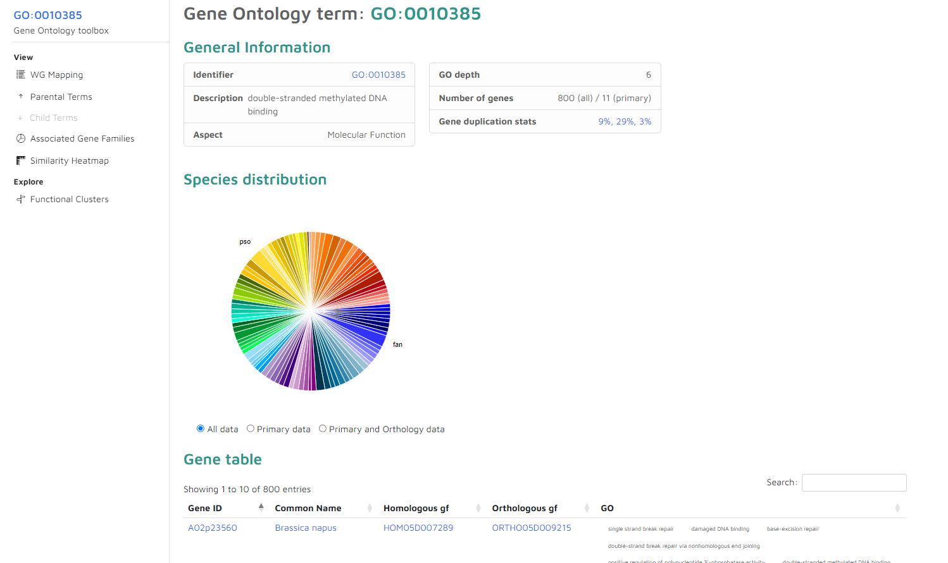
GO page
Same general layout as other pages with gene sets (e.g. gene families)
Use pie-chart of table to get subset
These gene-sets contain also the gene associated with child GO terms!

Slide 8
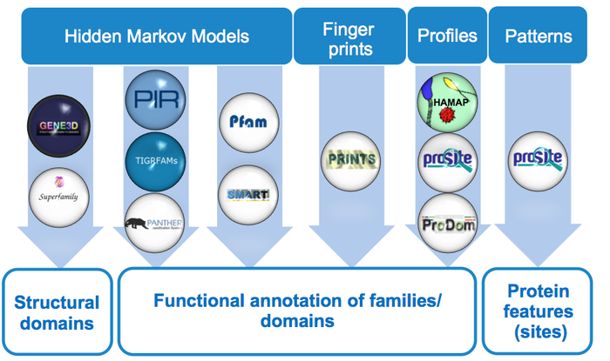
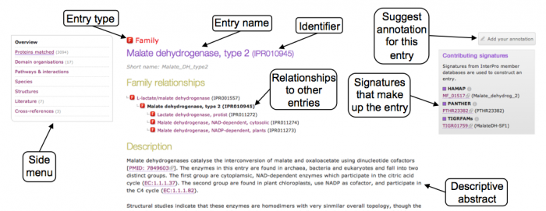
InterPro: protein sequence analysis & classification
Provides functional analysis of protein sequences by classifying them into families and predicting the presence of domains and important sites.
To classify proteins in this way, InterPro uses predictive
models, known as signatures, provided by several
different databases

Slide 9
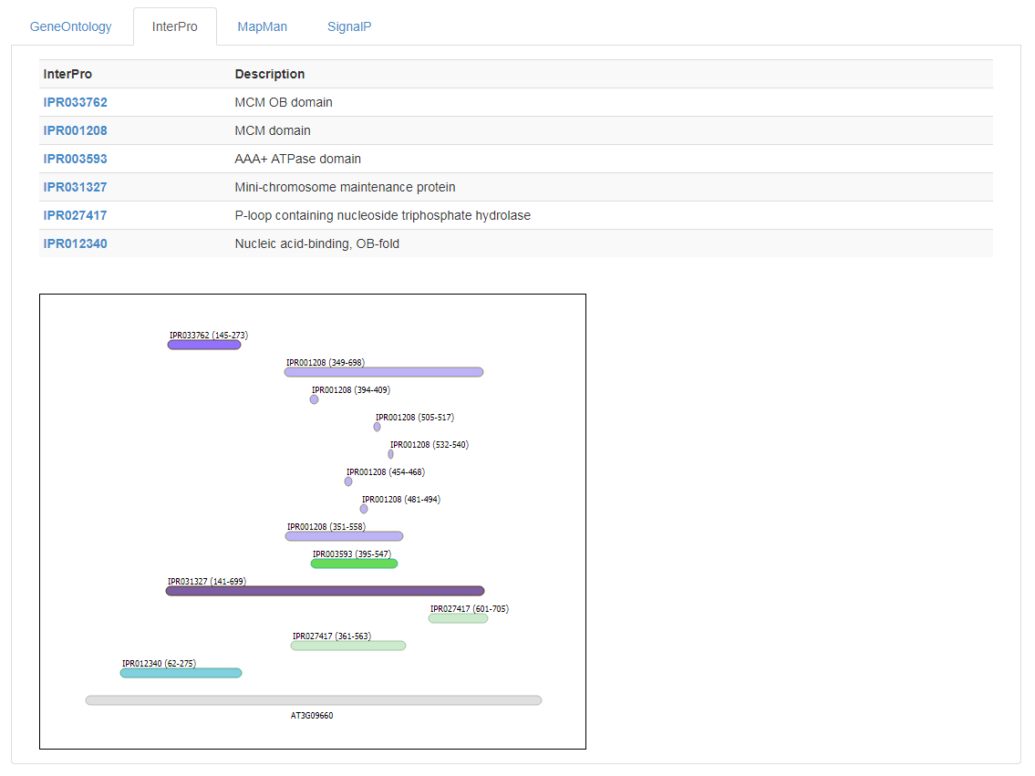
Gene Page: functional InterPro information

Slide 10
MapMan: Protein Classification and Annotation Framework
Plant-specific ontology designed to facilitate the visualization of omics data on plant pathways
Introduced as an alternative to Gene Ontology (GO)
Structure
  Hierarchical tree structure → easier than the graph structure of GO
  Multiple ‘bins’ at the top-level
  (e.g. 1 == Photosynthesis, 2 == Cellular respiration)
  The description of each term contains its parental terms description as well
    1 == Photosynthesis
    1.1 == Photosynthesis.photophosphorylation
    1.2 == Photosynthesis.calvin cycle
    1.1.1 == Photosynthesis.photophosphorylation.photosystem II

Slide 11
MapMan: Protein Classification and Annotation Framework
Annotation
  Most genes are annotated with only a single MapMan term
Effect : the most descriptive term of MapMan must confer more information than the most descriptive term of GO, in order to be equally useful
  GO (depth 12)
    GO:0044019 ➔histone acetyltransferase activity (H3-K72 specific)
  Mapman (depth 7)
    13.3.6.5.2.1.1.1 ➔ Cell cycle organisation.mitosis and meiosis.meiotic recombination.meiotic crossover.class II interference-insensitive crossover pathway.MUS81-dependent pathway.MUS81-EME1 Holliday junction cleavage heterodimer.component MUS81

Slide 12
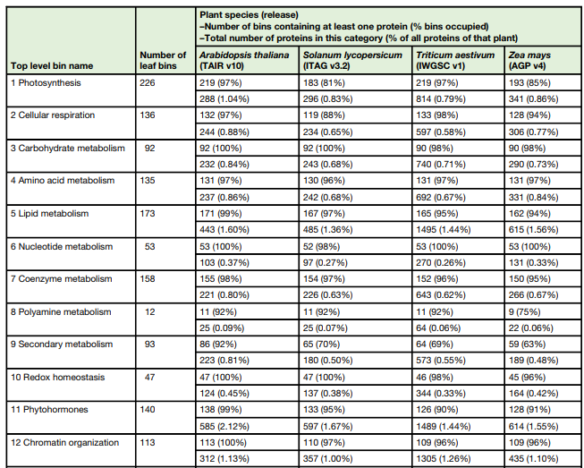
MapMan: Functional assignment comparison
Source:
MapMan4: A Refined Protein Classification and Annotation Framework Applicable to Multi-Omics Data Analysis
Molecular Plant 2019

Slide 13
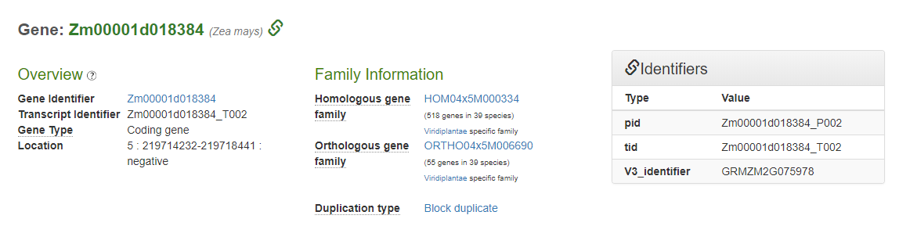
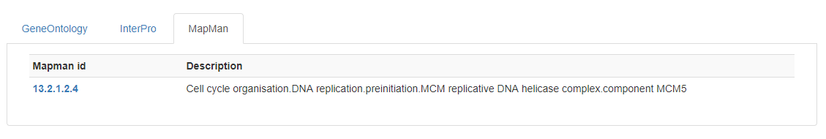
Gene Page: functional MapMan information

Slide 14
Enrichment analysis of gene sets
For a set of genes:
  What are there associated GO terms?
  Are there GO terms that are overrepresented (compared to ….)? Are there GO terms that are underrepresented?
  How can we find these overrepresented GO terms?
  How can we test whether the overrepresentation could occur by chance?
  GO Enrichment analysis of get sets
  Can be extended to other ontologies
More information:The Gene Ontology Handbook
http://gohandbook.org/doku.php

Slide 15
GO Projection: Concept and Rational
Experimentally validated GO information
  Available for many genes of model-species (e.g. based on knockout, expression analysis, etc.),
  Not available for species of interest
  Indicated using different GO evidence codes
→ Solution: transfer knowledge from model species to crop species!

Slide 16
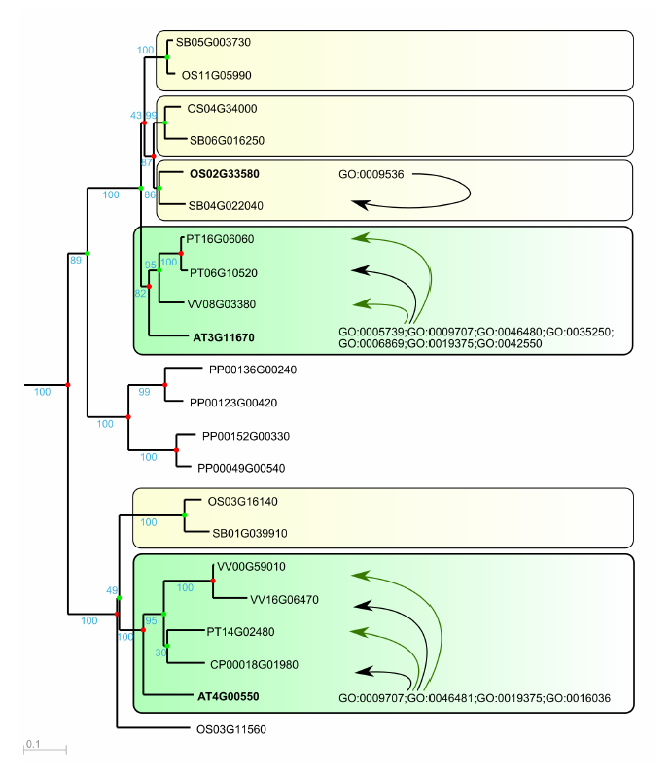
Functional annotation through GO projection
Orthology-based
1. Tree-based orthology
2. Integrative orthology
Homology-based
Enrichment + 50% rule
Orthology-based
Homology-based
Transfer of experimentally confirmed GO information to orthologs and homologs

Slide 17
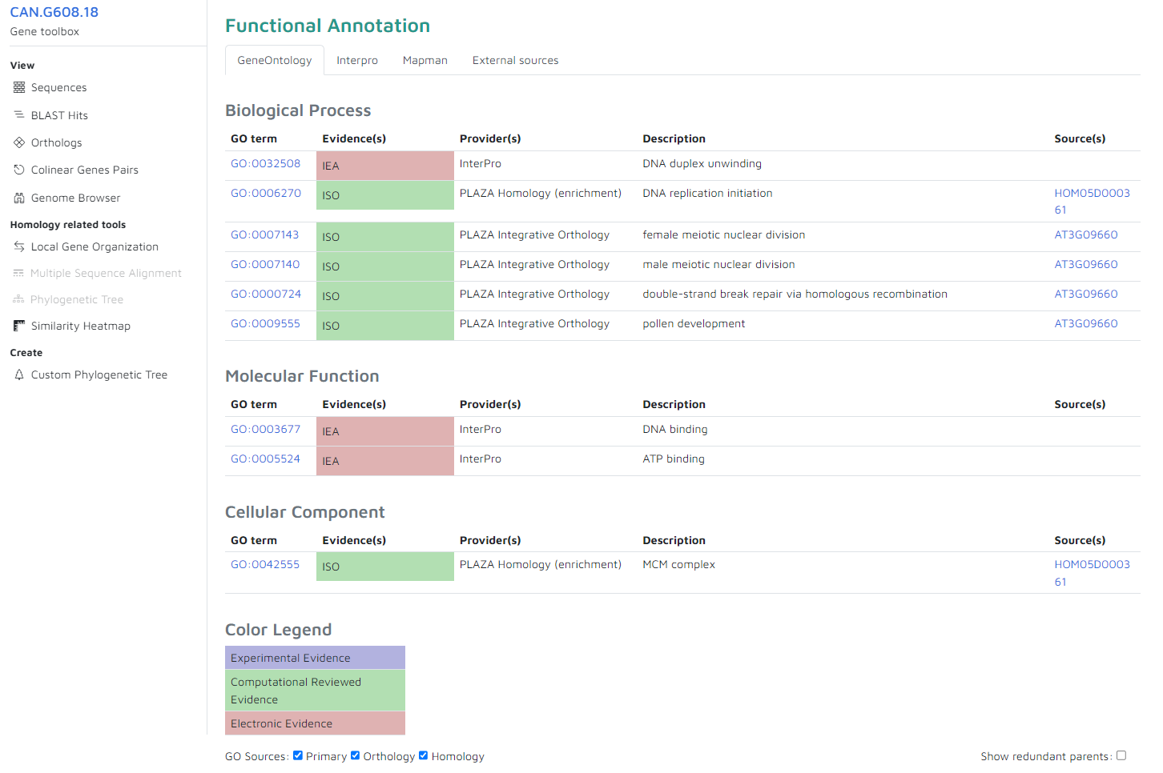
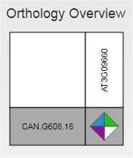
Gene Page: projected GO annotations

Slide 18
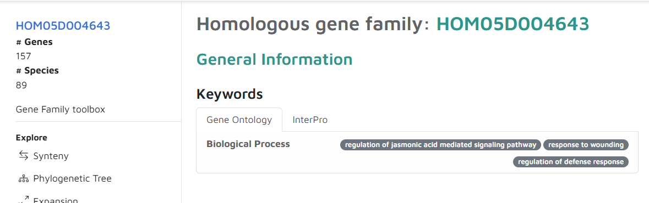
Gene Family Page : Functional Annotation
GO-terms are automatically assigned to gene families based on
  Enrichment statistics
  Fraction of genes in the family with the GO term
Do not use projected GO terms (prevent circular reasoning)
Does not mean that ALL genes of the family have that GO term
Multiple families can be annotated with the same GO term

Slide 19
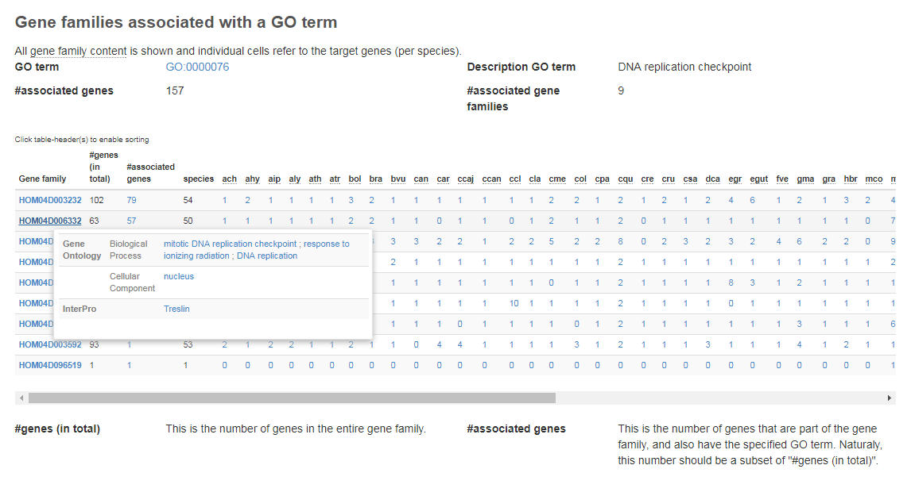
Associated gene families & phylogenetic profiles

